Slide 1
PAPER 1 ENGLISH LANGUAGE IGCSE (CIE)

Slide 2
Contents
Overview
Section 1: Reading and answering 2 big questions on texts (Q1-2)
Section 2: A choice of two writing tasks (Q 3)

Slide 3
Overview
Duration: 2 hours
Number of questions: 3 main questions (Q 1 and Q 2 have sub-questions)
Marks: 80 marks
Total marks for reading: 65 marks
Total marks for writing: 15 marks

Slide 4
Section 1: Reading and answering 2 big questions on texts (Q1-2)
Reading Texts (15 min)
Question 1(a-e) (Text A )
Comprehension (15 marks/ 15-20 min)
Question 1(f) (Text B)
Write a summary of no more than 120 words based on the text (15 marks/20 min)

Slide 5
Section 1: Reading and answering 2 big questions on texts (Q1-2)
Question 2(a-c) (Text C)
Short-answer questions (10 marks/ 15 min)
Question 2(d) ( Text C)
Write 200-300 words in response to a question focused on certain paragraphs in Text C
Select three relevant examples of interesting uses of language from each of the paragraphs specified
Analyse these examples to show how the writer uses language to convey meaning and to create effects
(15 marks/ 20 min)

Slide 6
Section 2: A choice of two writing tasks (Q 3)
Extended response to reading
Read Text C
Write 250-350 words in response to the task
Use and develop ideas and details from Text C
Write in your own words in one of the following formats: letter, report, journal, speech, interview or article
(25 marks/40 min)

Slide 7
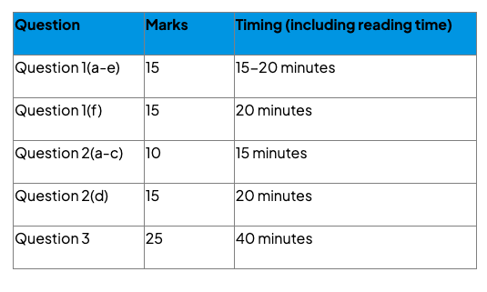
Time Management

